Slide 1

CREATIVE PROPOSAL

Slide 2


Content Proposal
What’s Included

Slide 3



By approving this proposal, you accept that there will be NO substantial changes in the copies, architecture or focus of the images. You agree that you have thoroughly read and understood the proposal and that any significant changes might carry additional costs for the project.

Slide 4
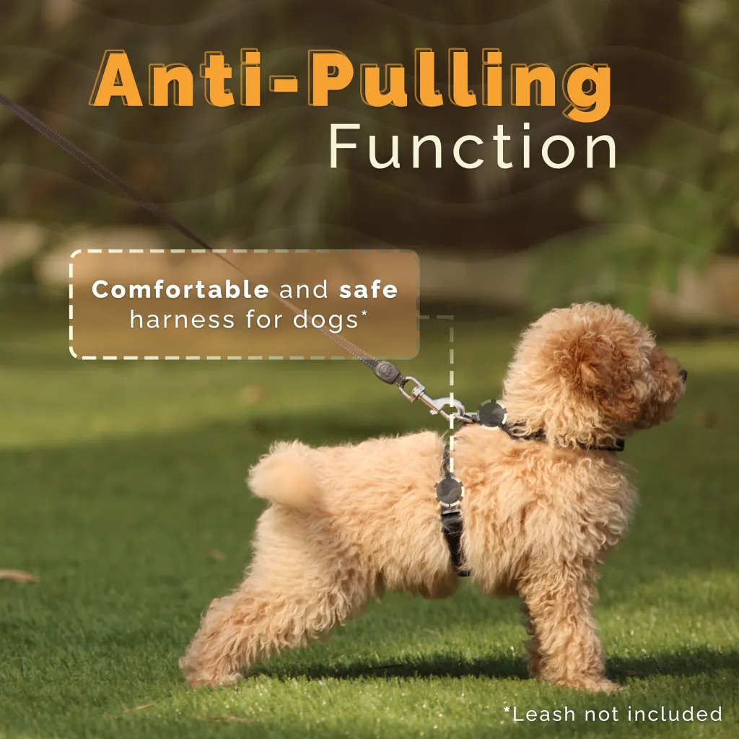
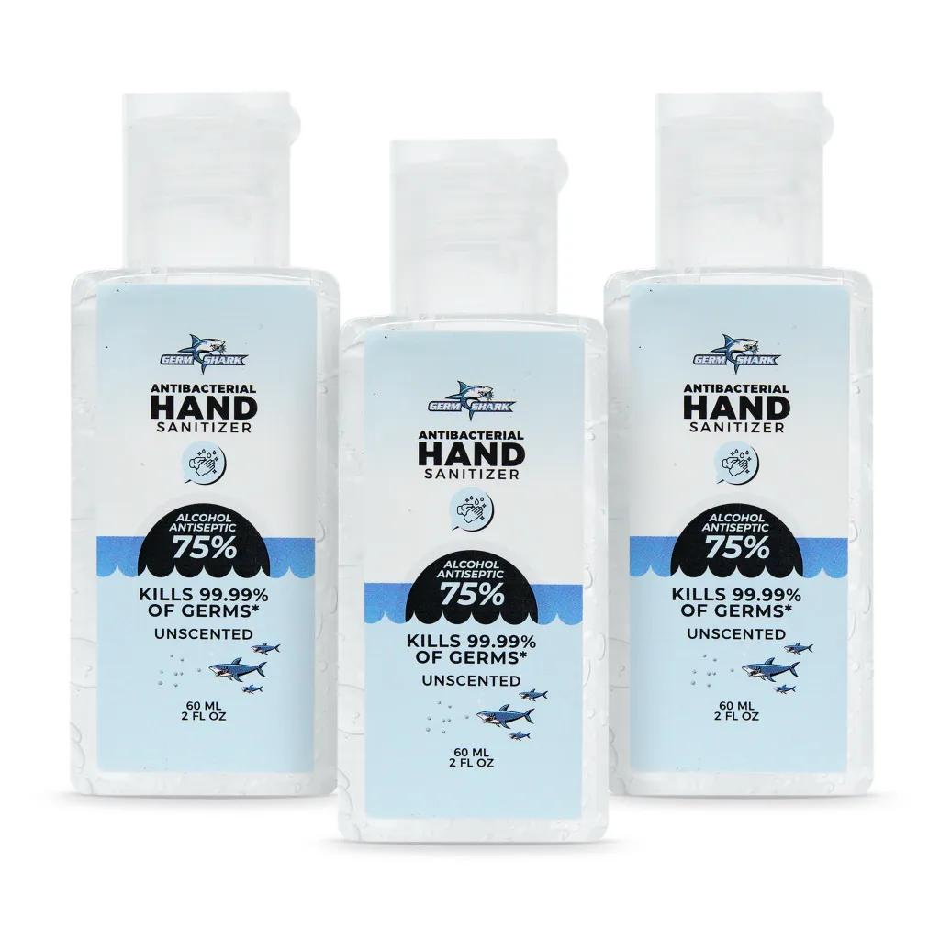
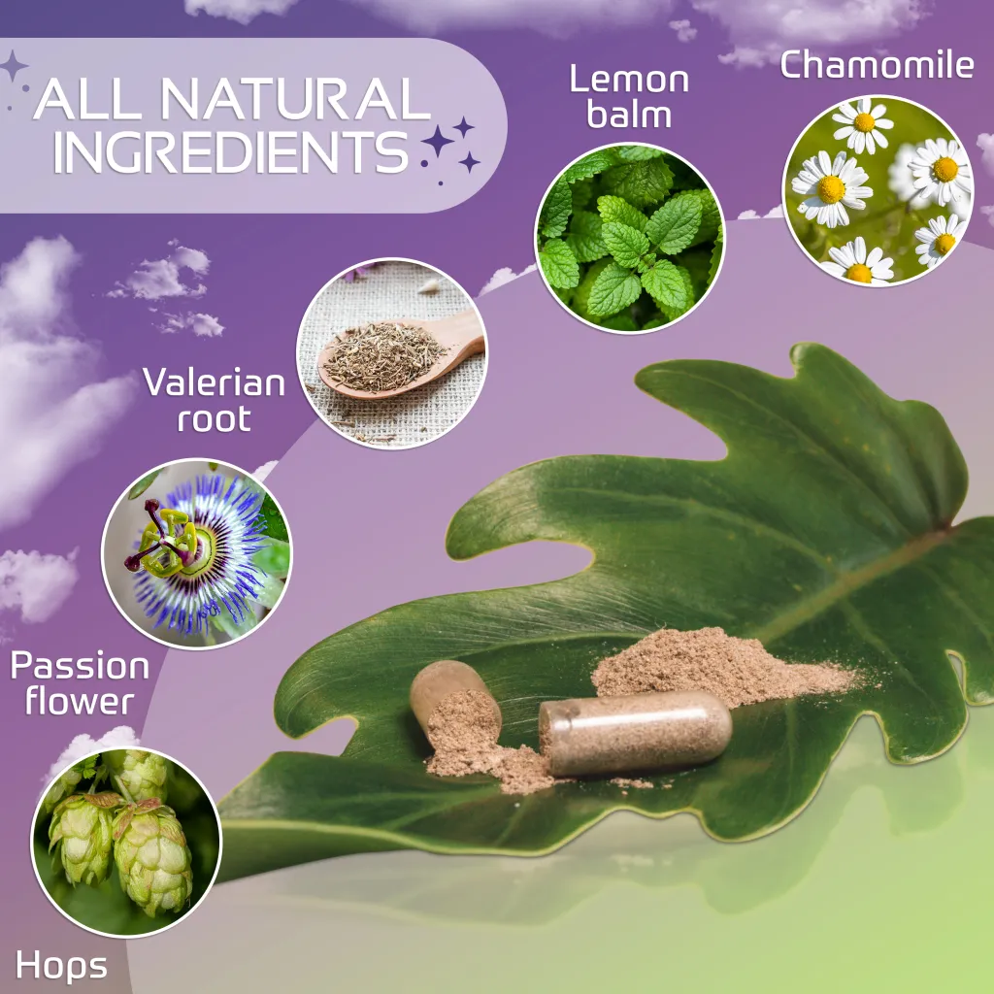
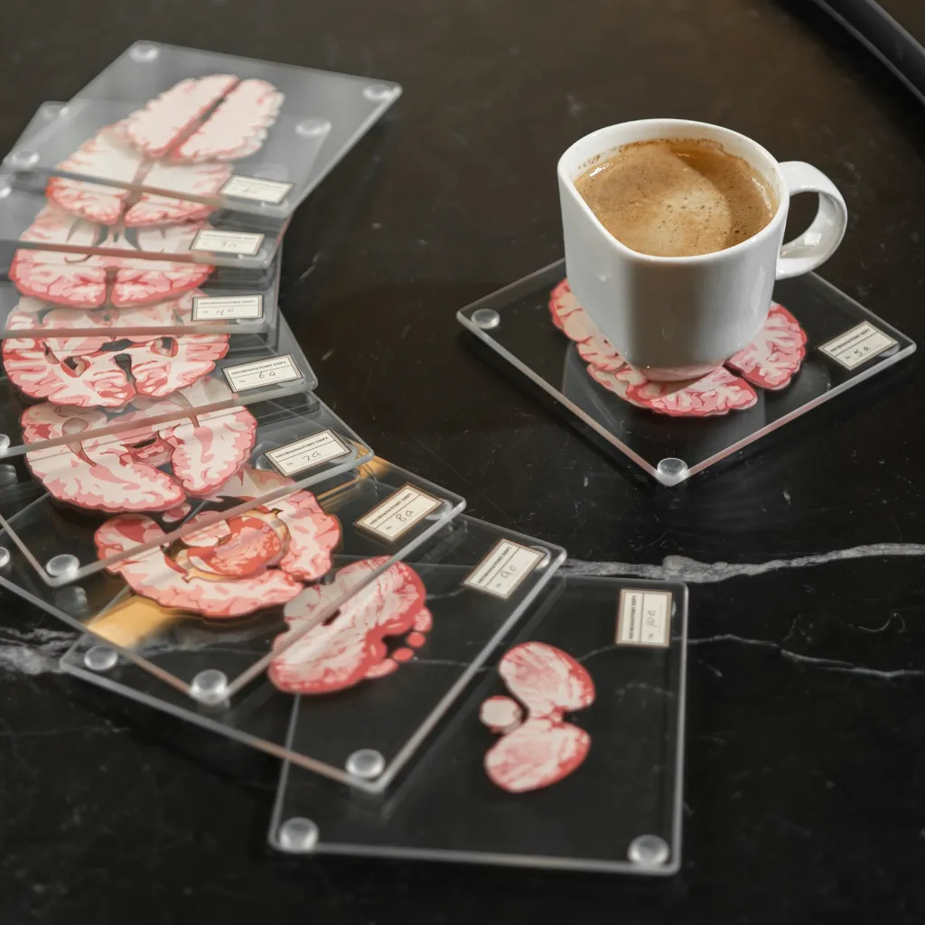
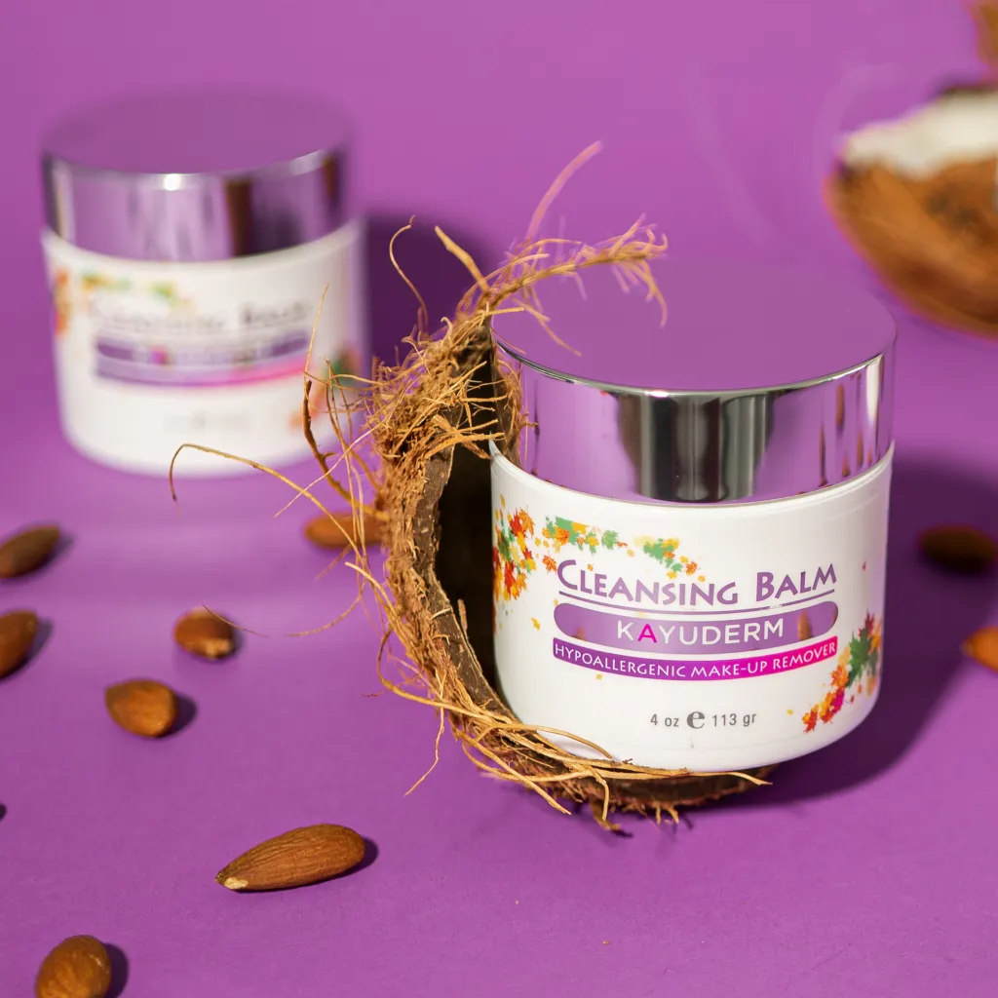
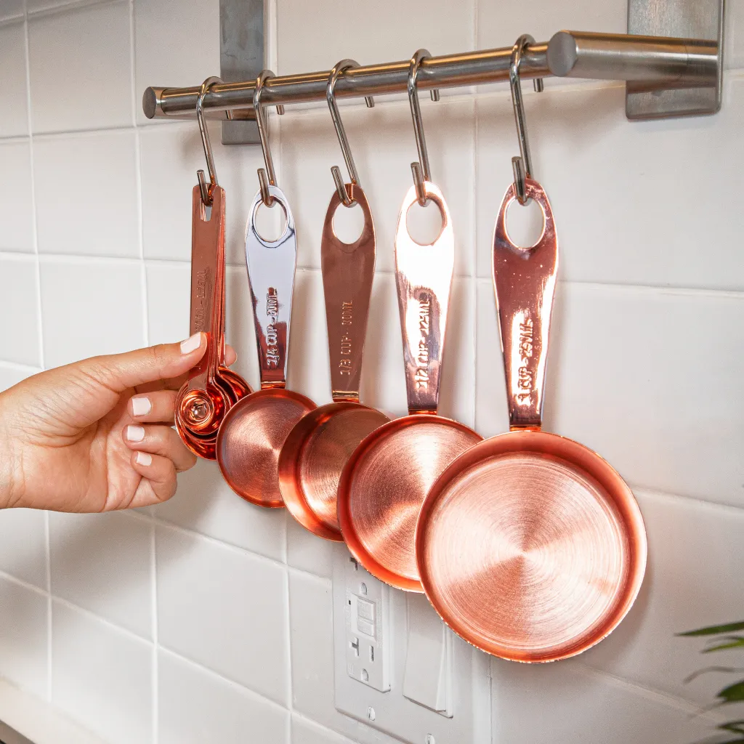
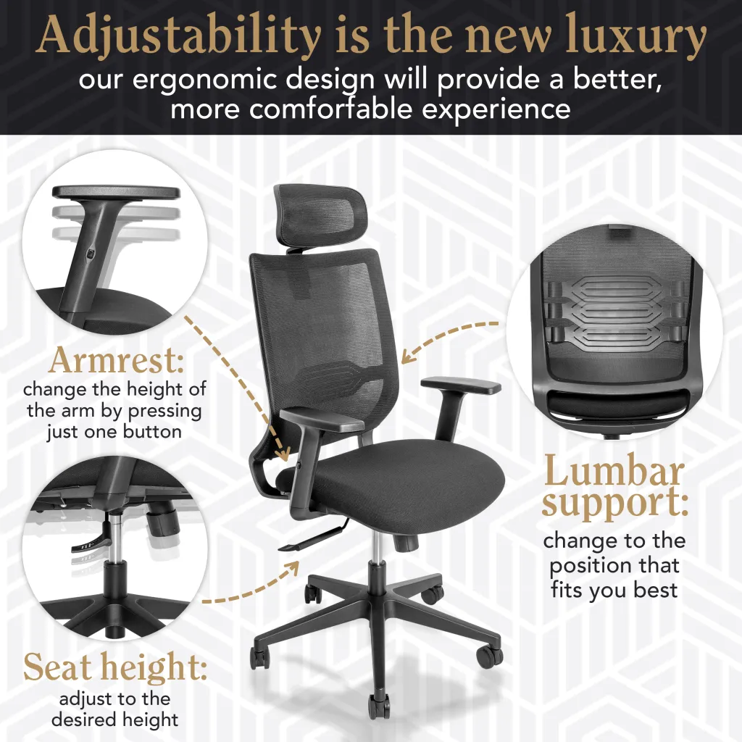
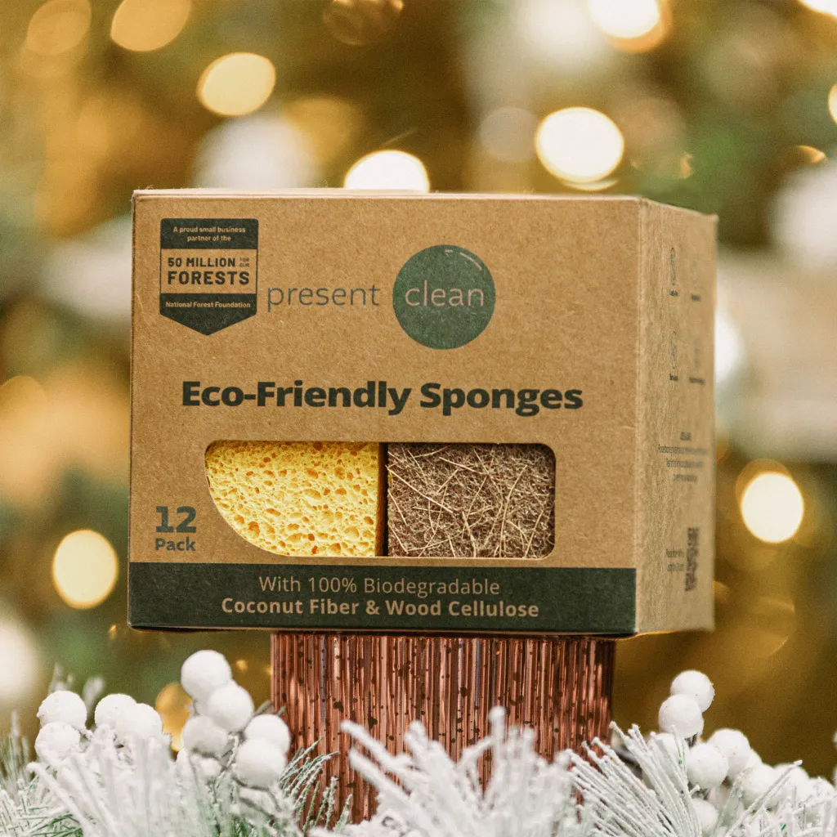
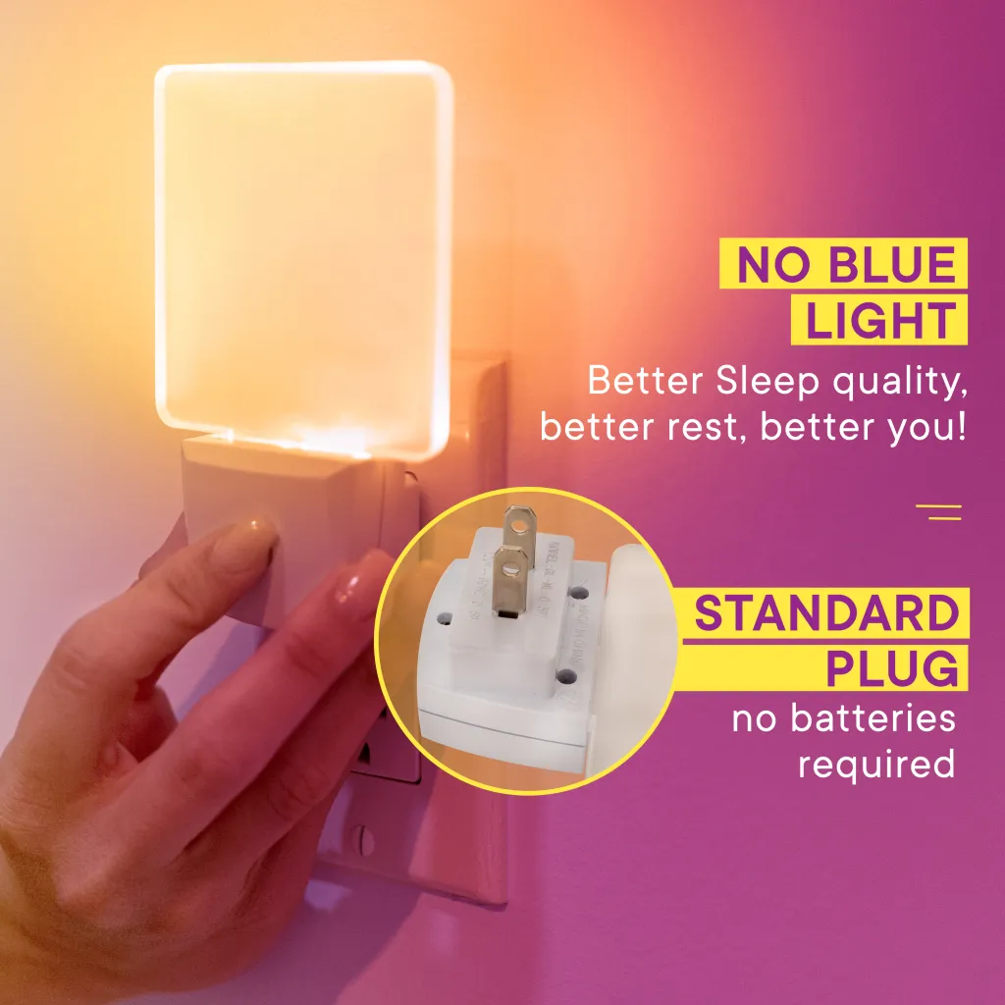
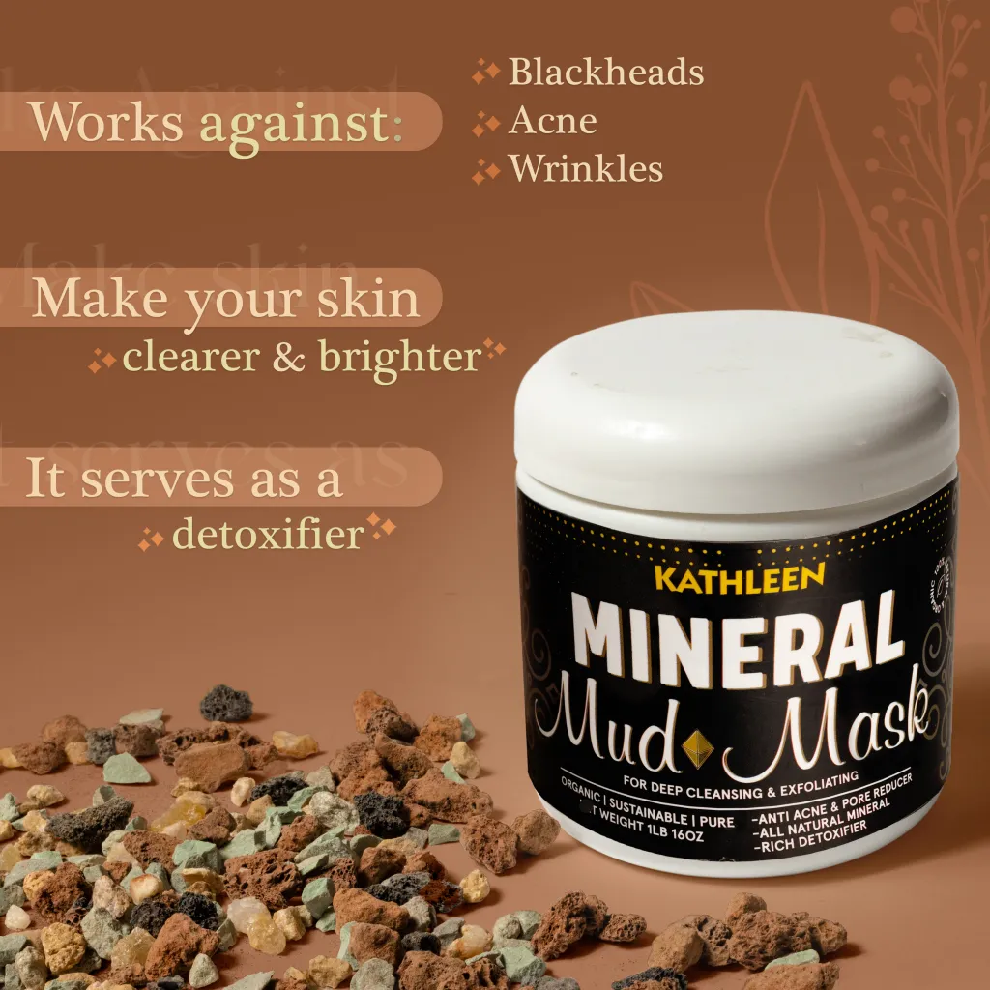
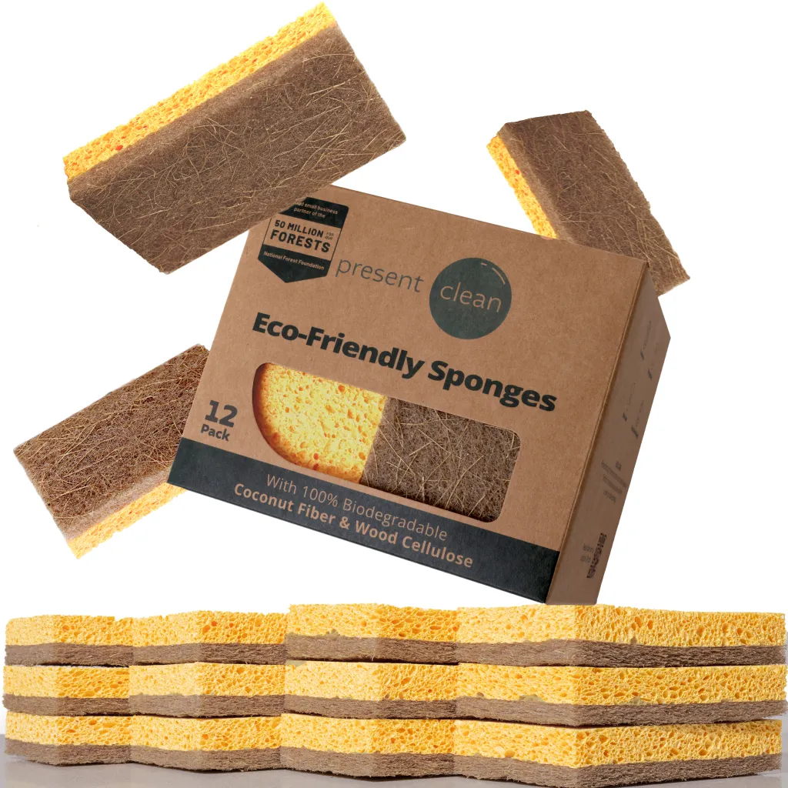
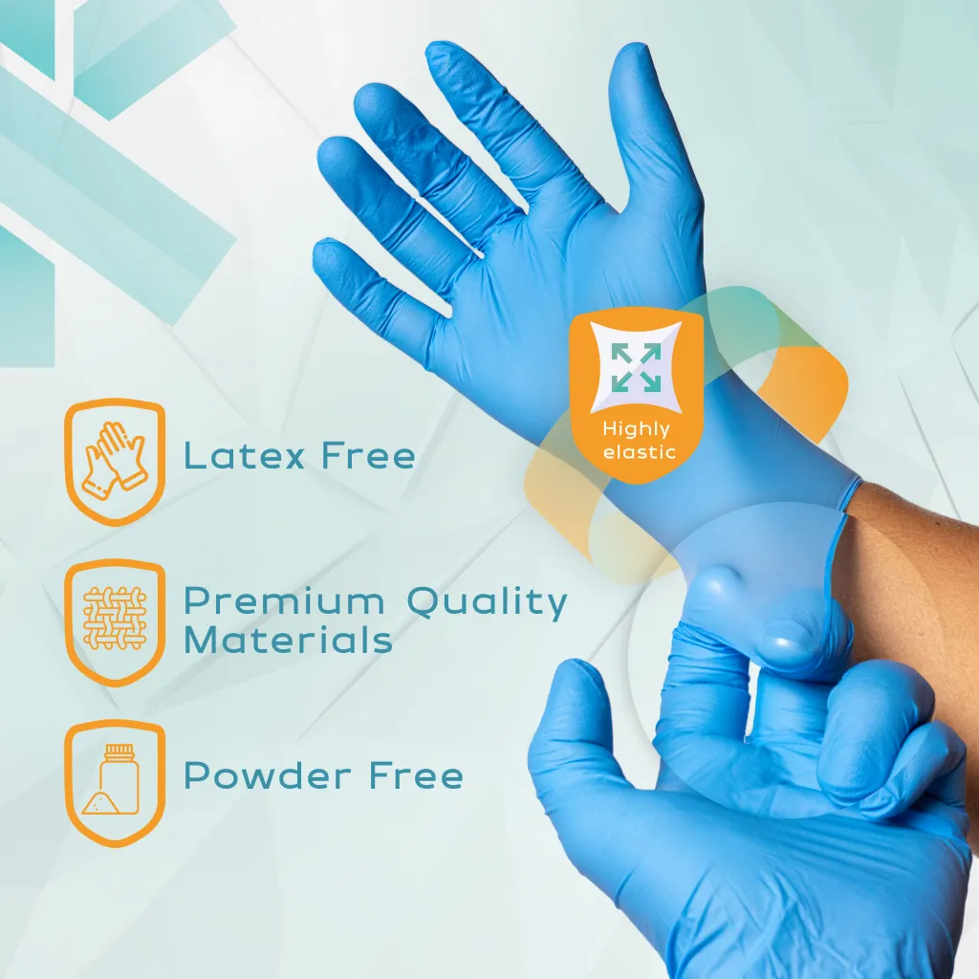
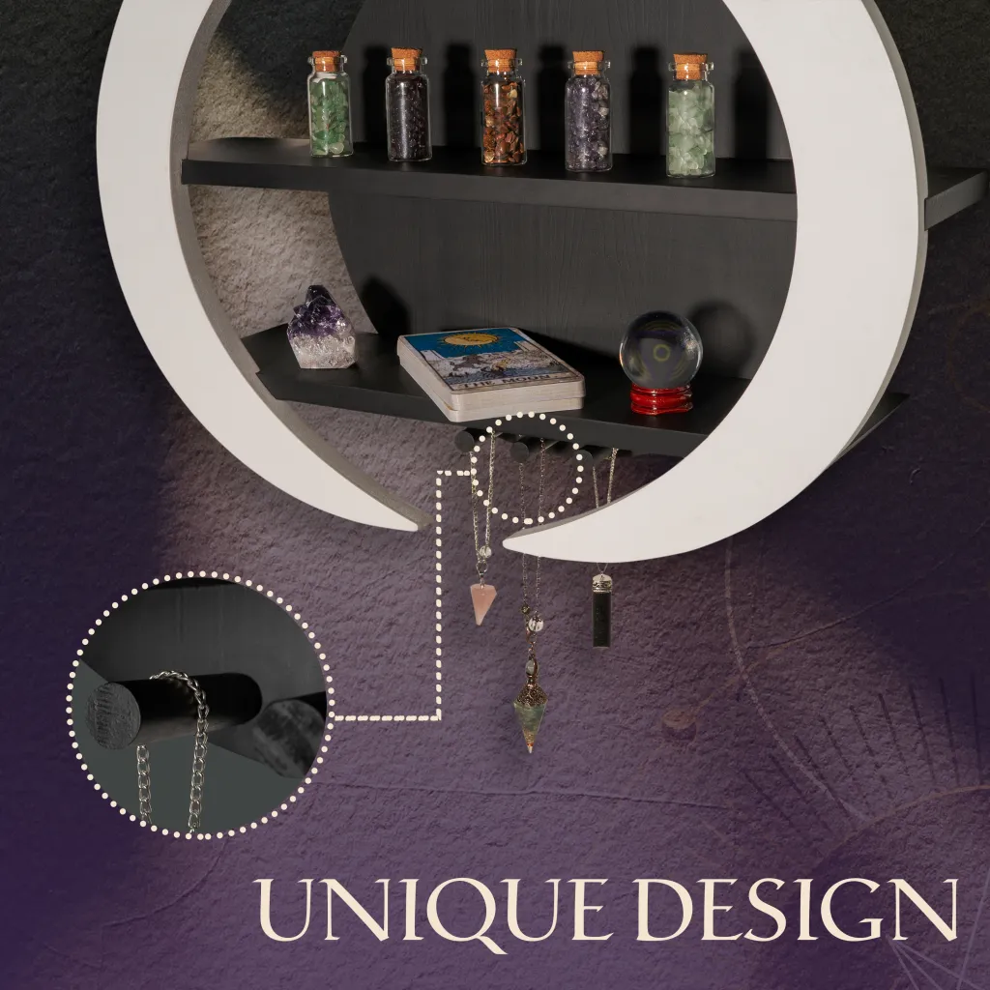
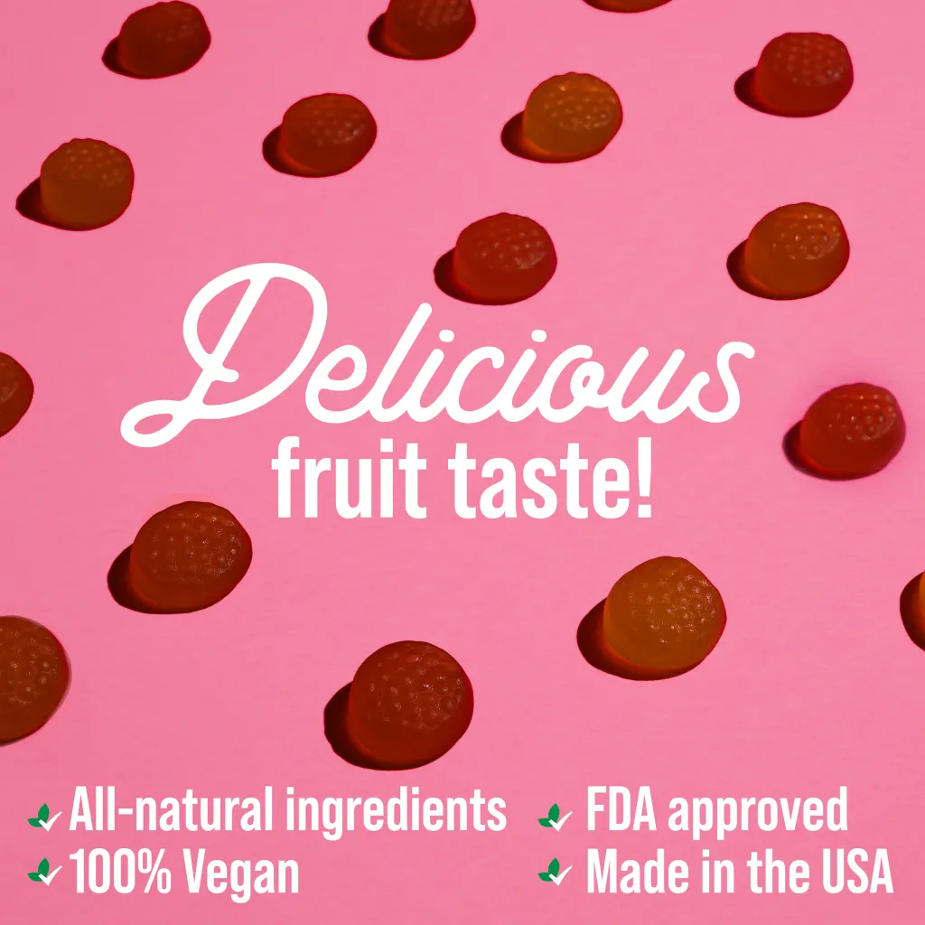
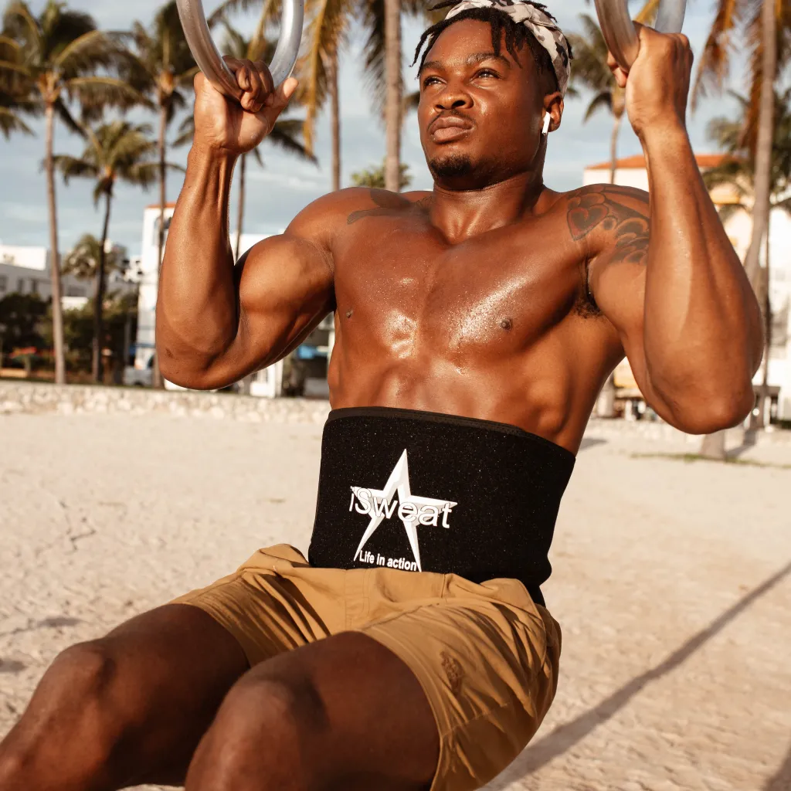
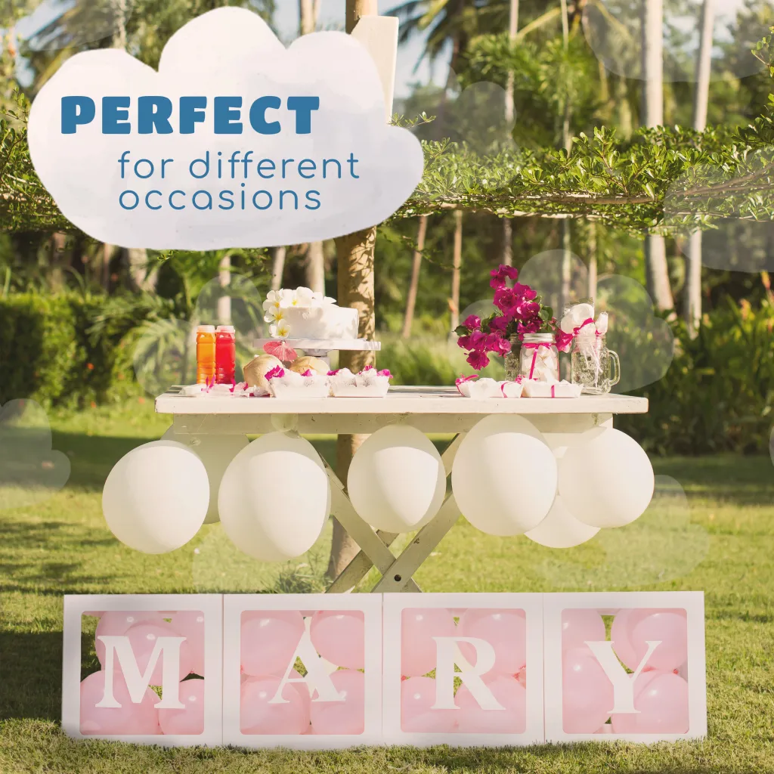
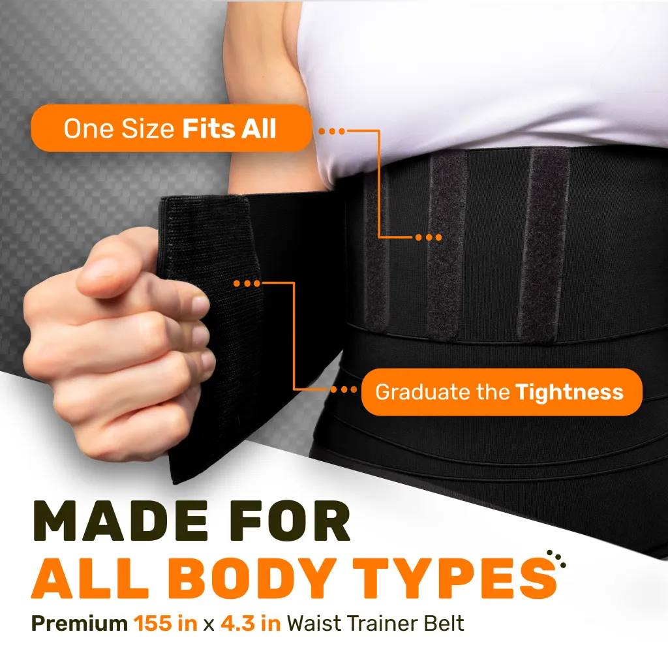
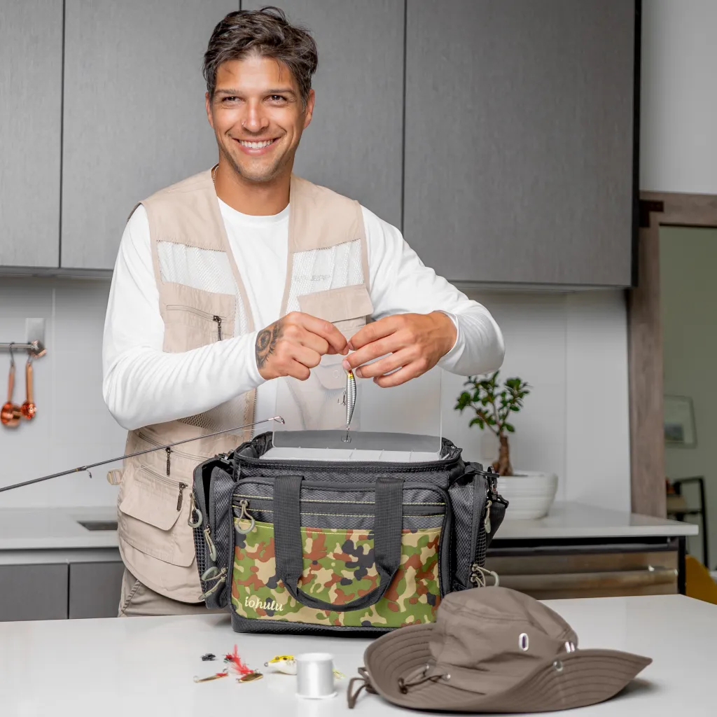
Reference images
from our portfolio

Slide 5


Insights
Reviews Insights
First, we studied the reviews of the competitor with the most reviews and with better ratings (4-5 stars) to analyze which features satisfy most clients.
Suggested Image list
Insights
Insights

Slide 6
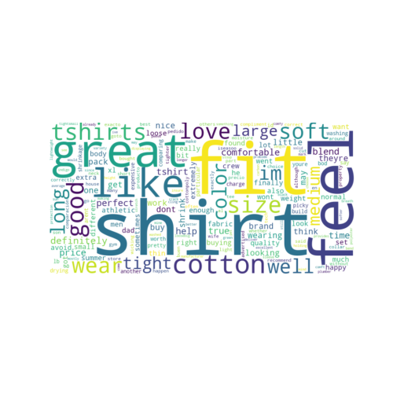
Insights
Reviews Insights
Suggested Image list
Insights
Insights

Slide 7
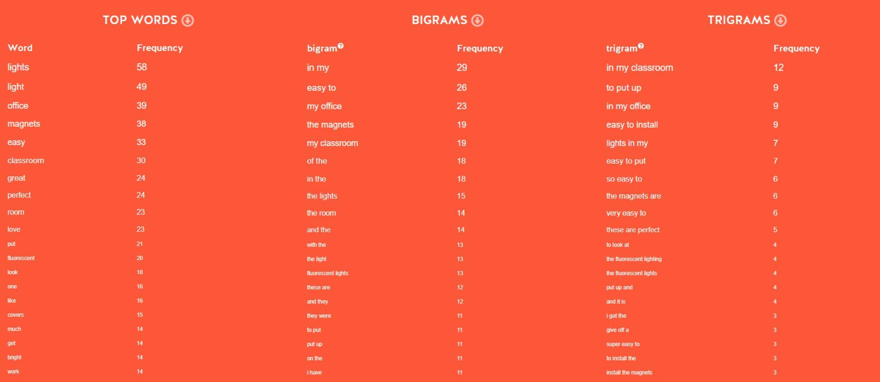
Insights
Reviews Insights
TOP WORDS
shirt | 18
fit | 16
feel | 11
great | 10
like | 10
cotton | 9
good | 7
tshirts | 7
size | 7
soft | 6
love | 6
wear | 6
im | 5
long | 5
color | 5
well | 5
tight | 5
medium | 5
large | 4
definitely | 4
BIGRAMS
true size | 4
soft comfortable | 3
large fit | 2
fit great | 2
shirt great | 2
like much | 2
cotton blend | 2
like thin | 2
thin shirt | 2
summer time | 2
love feel | 2
love wearing | 2
great fit | 2
long enough | 2
wont shrink | 2
like cotton | 2
different color | 2
shrink get | 2
fit well | 2
pretty good | 1
TRIGRAMS
like thin shirt | 2
pretty good quality | 1
good quality soft | 1
quality soft shrinkage | 1
soft shrinkage washing | 1
shrinkage washing drying | 1
washing drying large | 1
drying large fit | 1
large fit im | 1
fit im lb | 1
im lb im | 1
lb im happy | 1
im happy shirt | 1
happy shirt fit | 1
shirt fit great | 1
fit great im | 1
great im athletic | 1
im athletic build | 1
athletic build comparing | 1
build comparing expensive | 1
Suggested Image list
Insights
Insights

Slide 8
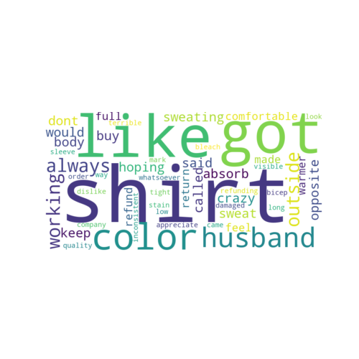
Insights
Reviews Insights
Second, we study the worst ratings (1-2 stars) to understand what should be fixed or highlighted to avoid disappointment in the buyer persona.
Suggested Image list
Insights
Insights

Slide 9
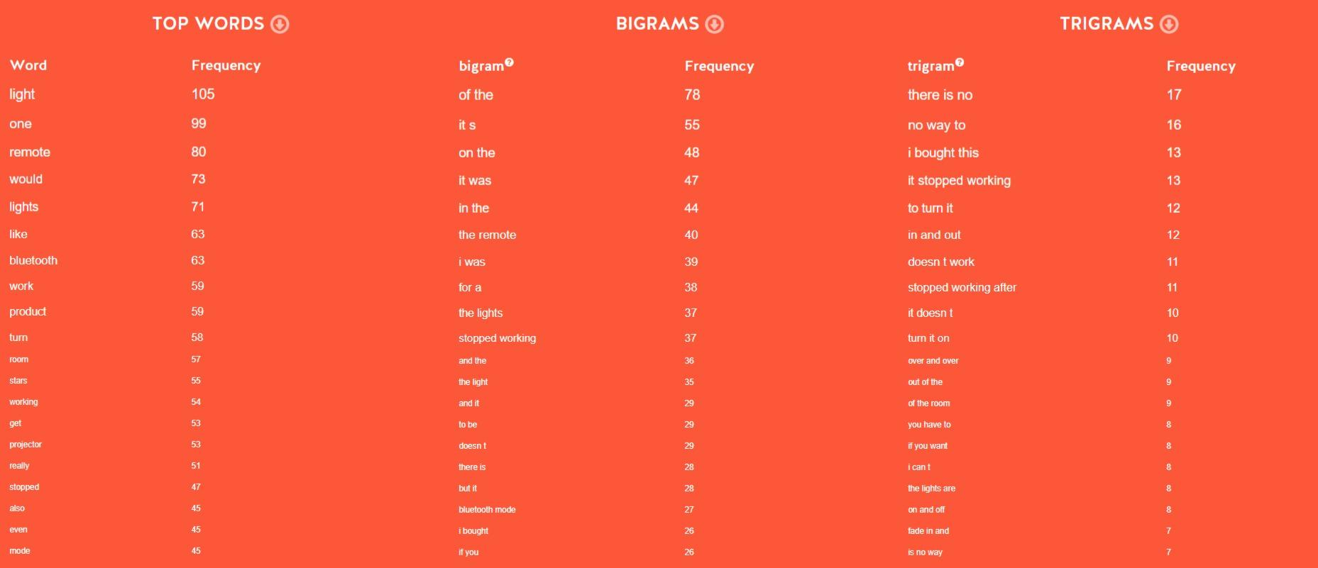
Insights
Reviews Insights
TOP WORDS
shirt | 4
got | 2
like | 2
color | 2
husband | 1
always | 1
working | 1
outside | 1
sweating | 1
crazy | 1
hoping | 1
would | 1
absorb | 1
sweat | 1
keep | 1
body | 1
opposite | 1
called | 1
said | 1
dont | 1
BIGRAMS
got shirt | 1
shirt husband | 1
husband always | 1
always working | 1
working outside | 1
outside sweating | 1
sweating like | 1
like crazy | 1
crazy hoping | 1
hoping would | 1
would absorb | 1
absorb sweat | 1
sweat keep | 1
keep body | 1
body opposite | 1
opposite called | 1
called said | 1
said dont | 1
dont buy | 1
buy shirt | 1
TRIGRAMS
got shirt husband | 1
shirt husband always | 1
husband always working | 1
always working outside | 1
working outside sweating | 1
outside sweating like | 1
sweating like crazy | 1
like crazy hoping | 1
crazy hoping would | 1
hoping would absorb | 1
would absorb sweat | 1
absorb sweat keep | 1
sweat keep body | 1
keep body opposite | 1
body opposite called | 1
opposite called said | 1
called said dont | 1
said dont buy | 1
dont buy shirt | 1
buy shirt comfortable | 1
Suggested Image list
Insights
Insights

Slide 10

Insights
Benchmark Analysis
Suggested Image list
Insights
Insights

Slide 11

Reference
Suggested Image list
Additional Suggested Images
Hero Images

Slide 12

Reference
Suggested Image list
Additional Suggested Images
Hero Images

Slide 13

Reference
Suggested Image list
Additional Suggested Images
Hero Images

Slide 14
Suggested Module List for A+
Module #1: On the sandy beach, show a model in his early 30s standing next to our Men's Crew Neck T-Shirts. He should be holding the shirts up, displaying the comfortable fabric blend and durability.
Title: Comfortable and Long-lasting Men's Tees
Text + icon: Breathable Cotton-Poly Blend
Text + icon: Durable and Preshrunk
Text + icon: Classic Design for Everyday Wear
Text + icon: Perfect Fit for All Body Types
Module #2: Close-up to the cotton-poly fabric blend and stitching details on the t-shirts
Title: Quality Materials for Lasting Comfort
Details:
• Soft and Lightweight Fabric
• Strong Stitching for Longevity
Module #3: In the background, a man wearing the Men's Crew Neck T-Shirts playing frisbee on the beach
Title: Stay Cool and Active in Your New Favorite Tee
Text + icon: Moisture-Wicking Fabric
Text + icon: Lightweight and Breathable
Text + icon: Comfortable for All-Day Wear
Module #4: Close-up of the t-shirts folded in a beach picnic set-up
Title: Versatile Men's Crew Neck Tees for Any Occasion
Text + icon: Ready for All Your Summer Adventures
Text + icon: Easy to Care for: Machine-Washable
Module #5: Close-up of a solo individual relaxing on the beach with the t-shirts
Title: A Must-Have Addition to Your Wardrobe
Text + icon: Classic Style Made Easy
Text + icon: Versatile Staple for Any Outfit
Remember to capture the model's expression and experience with each shot, emphasizing the comfort and quality of the Men's Crew Neck T-Shirts.
Suggested Image list
Additional Suggested Images
A+ content

Slide 15
Suggested Concept: Premium A+ Video
Scene 1: A man stands on the winter beach overlooking the ocean, wearing a Men's Crew Neck T-Shirt
Title: Comfortable All-Season Essential
Scene 2: Close-up of the man adjusting the collar of the Crew Neck T-Shirt
Title: Long-lasting Fit
Scene 3: The man takes off his jacket to reveal the lightweight and breathable fabric of the t-shirt
Title: All-Day Cool Comfort
Scene 4: The man does stretches and movements to show the flexibility and ease of movement in the t-shirt
Title: Flexible Fit for Any Activity
Scene 5: Quick shots of the different colors of the Men's Crew Neck T-Shirt in the 2/4 pack
Title: Stay Stylish in Every Shade
Include shots showcasing the preshrinking quality of the fabric and the reinforced stitching on the seams to highlight the durability of the product and emphasize the long-term value for the consumer. Make sure to focus on the features and benefits of the t-shirt while keeping the visuals simple yet effective on the winter beach background.
Additional Suggested Images
Suggested Image list
A+ content

