Slide 1

CREATIVE PROPOSAL

Slide 2


Content Proposal
What’s Included

Slide 3



By approving this proposal, you accept that there will be NO substantial changes in the copies, architecture or focus of the images. You agree that you have thoroughly read and understood the proposal and that any significant changes might carry additional costs for the project.

Slide 4



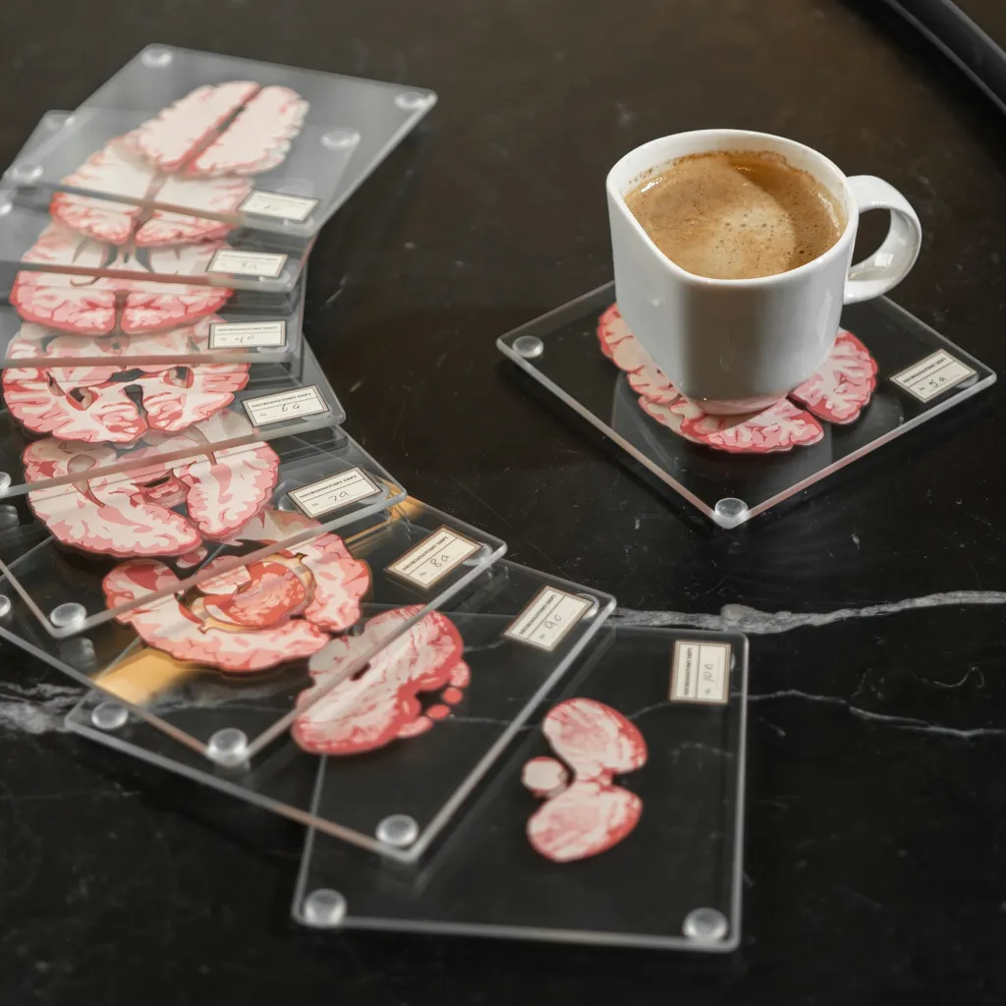

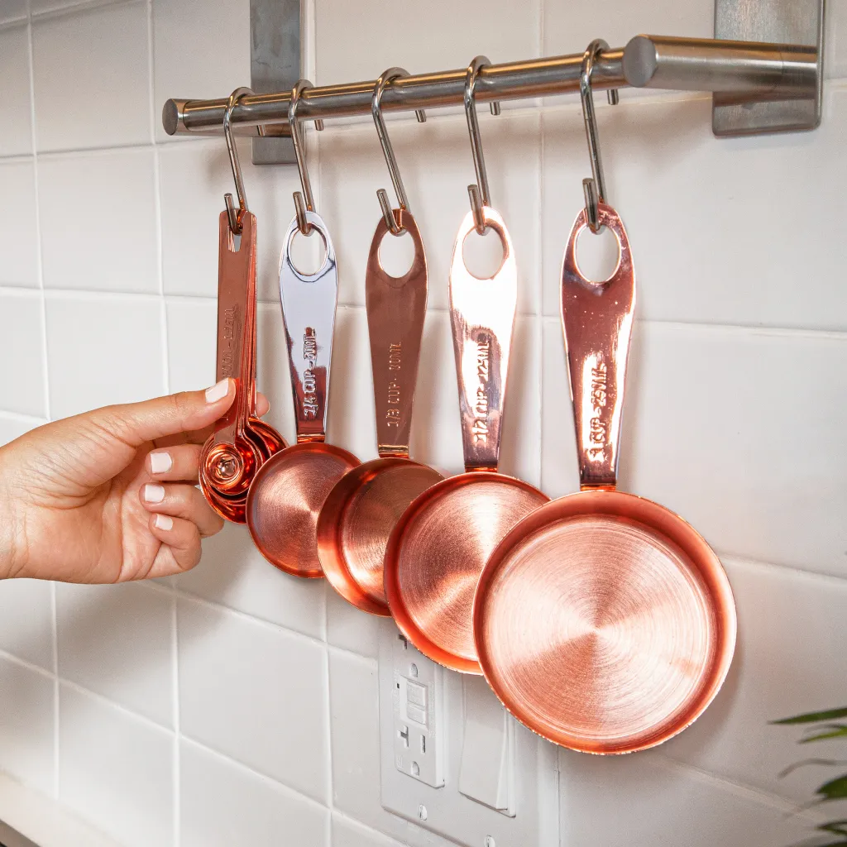
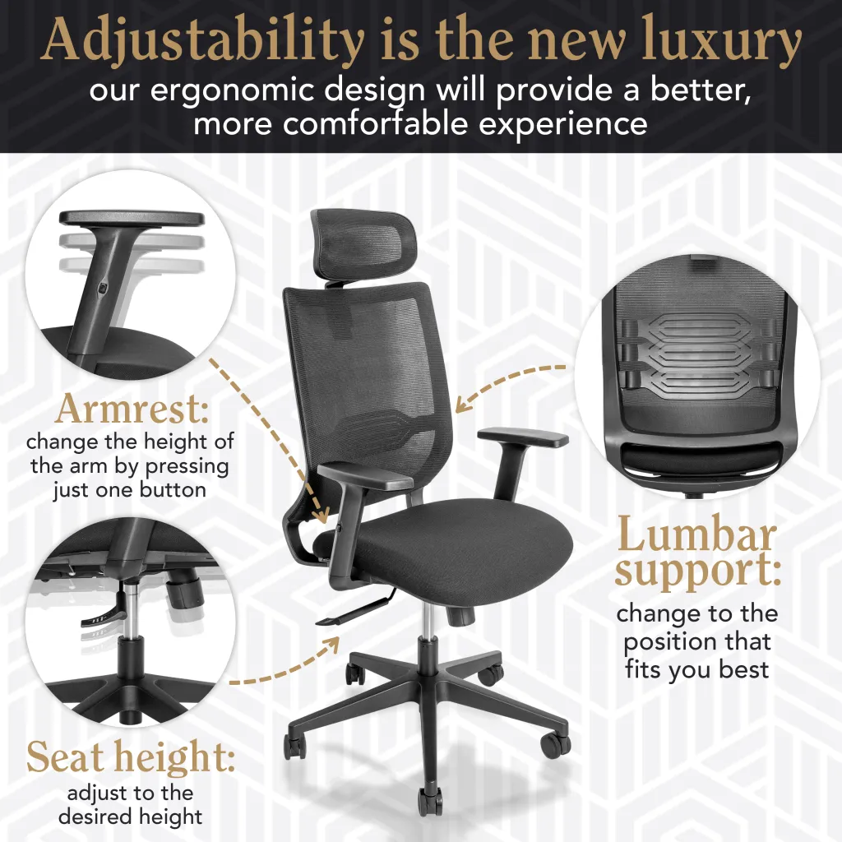

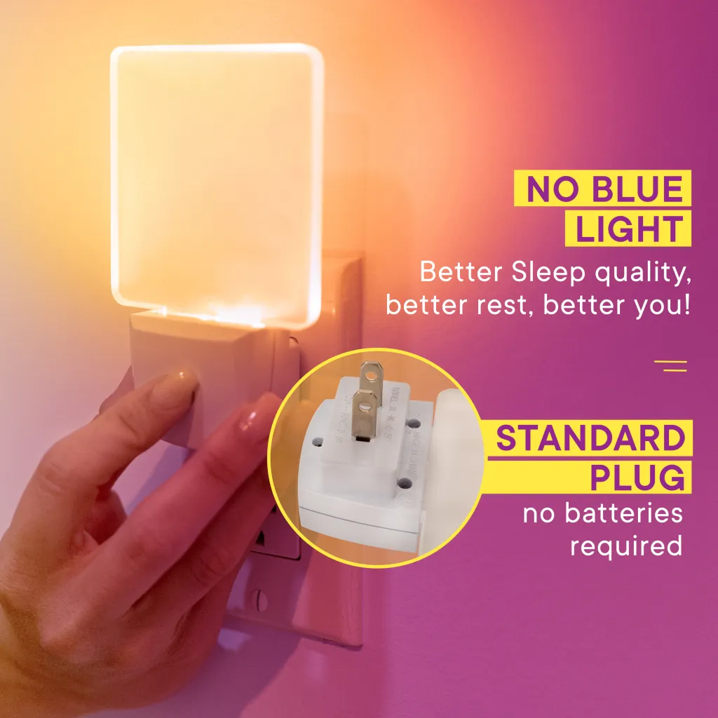
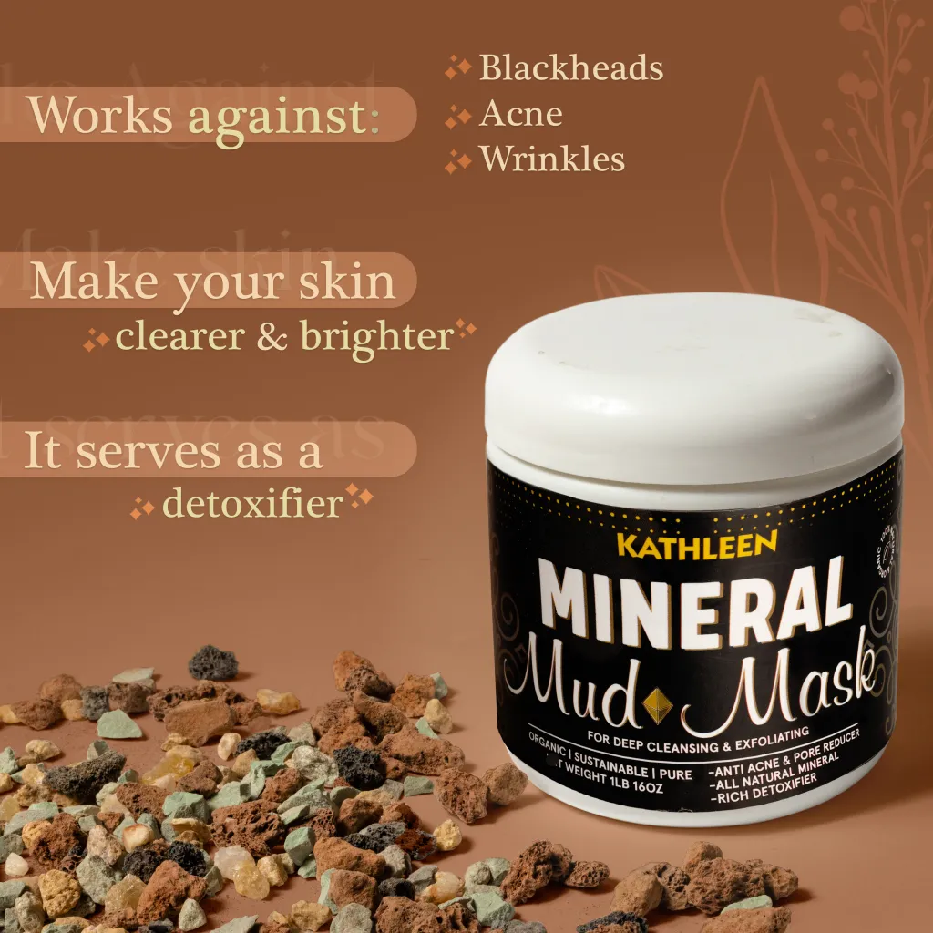
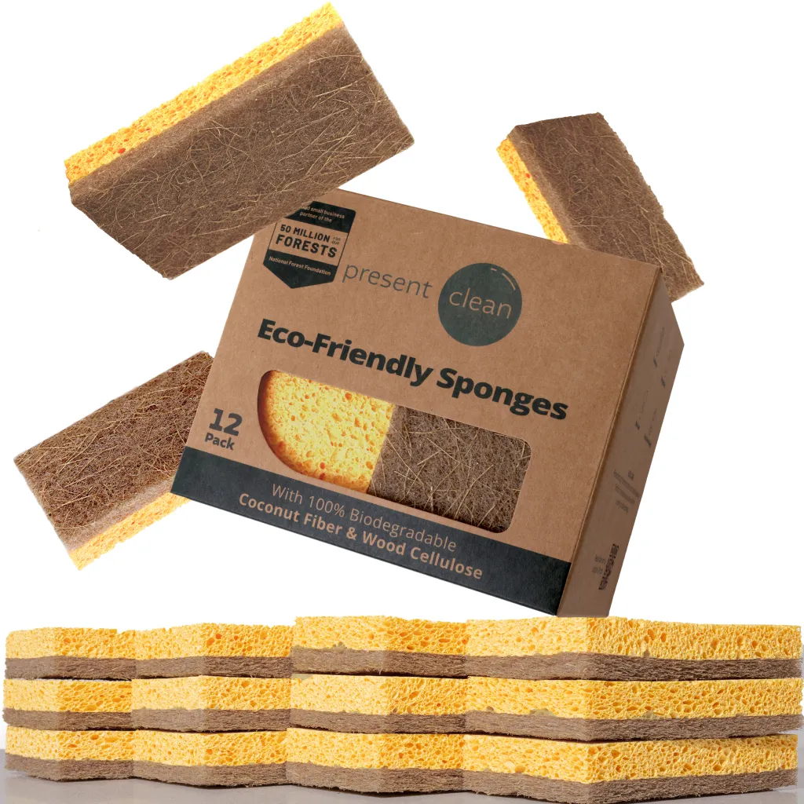

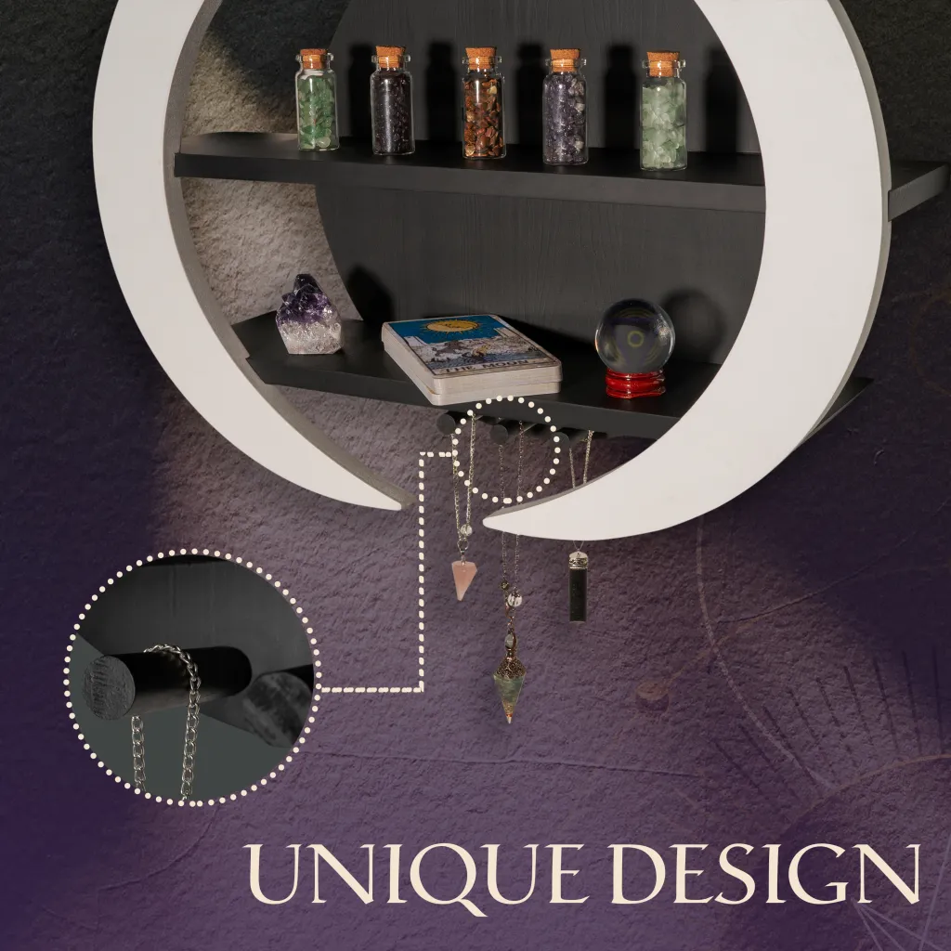

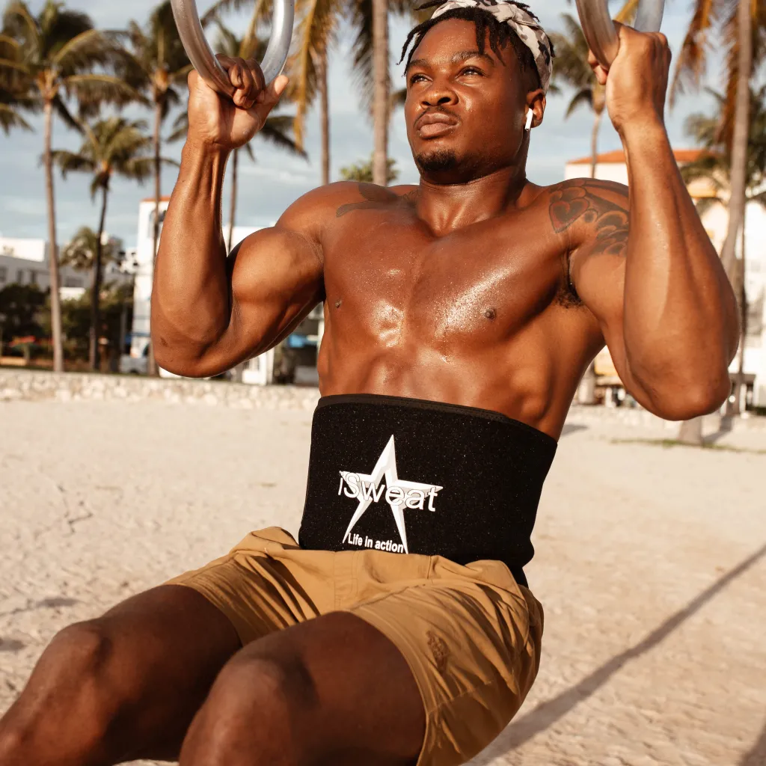



Reference images
from our portfolio

Slide 5


Insights
Reviews Insights
First, we studied the reviews of the competitor with the most reviews and with better ratings (4-5 stars) to analyze which features satisfy most clients.
Suggested Image list
Insights
Insights

Slide 6
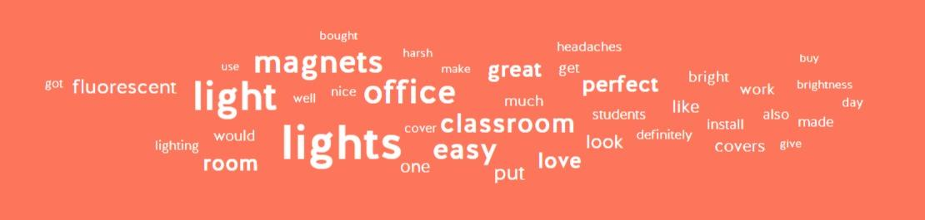
Insights
Reviews Insights
Suggested Image list
Insights
Insights

Slide 7
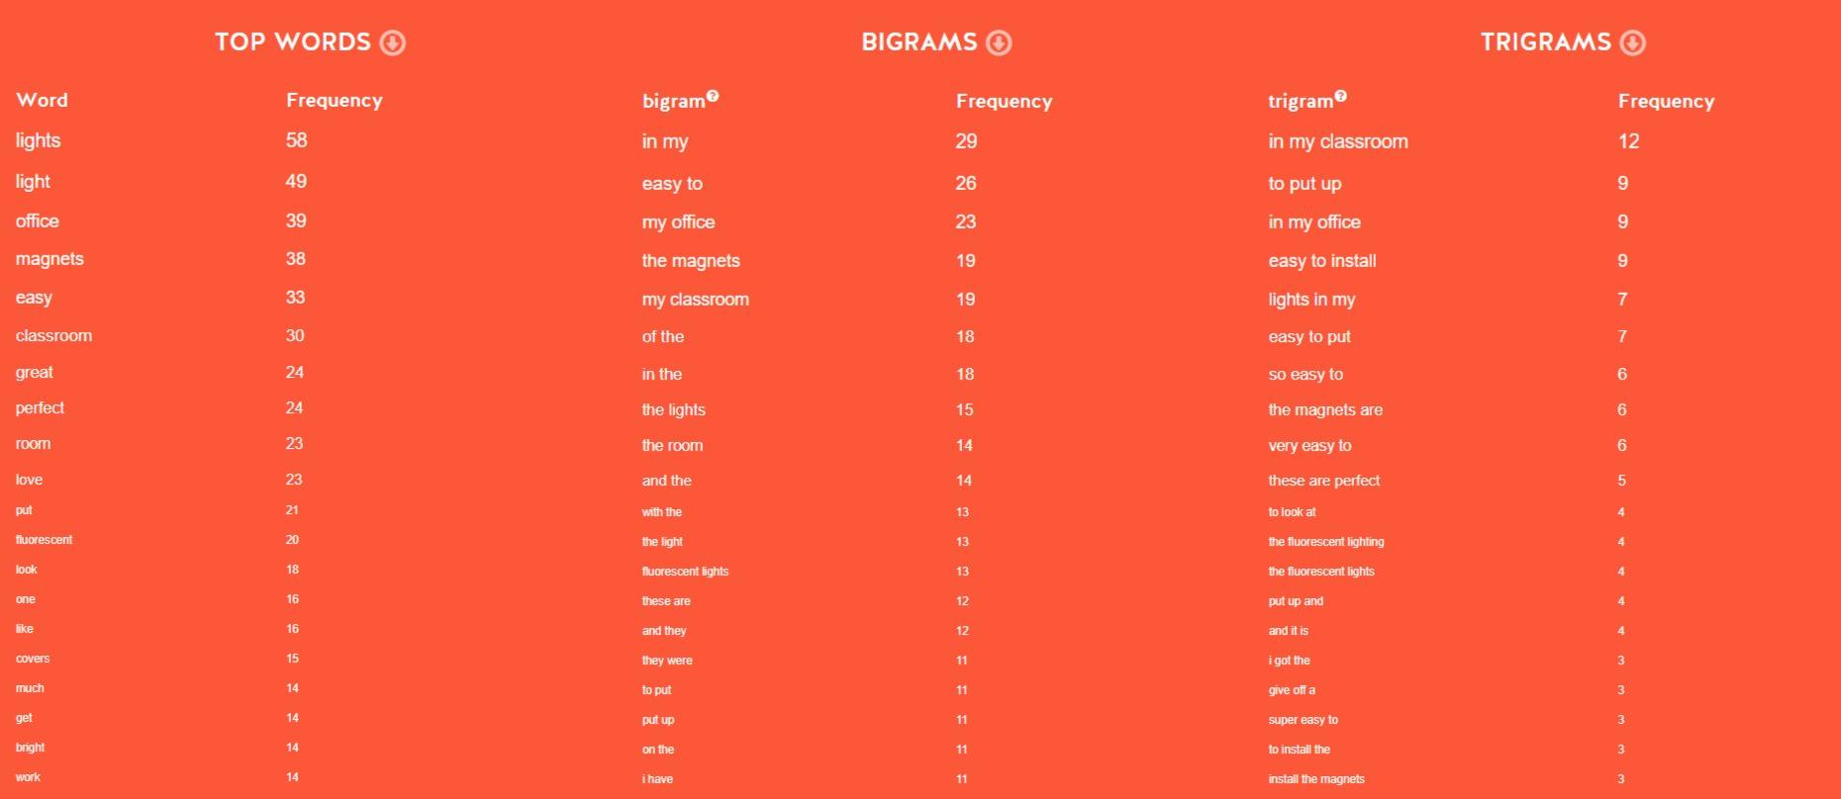
Insights
Reviews Insights
Suggested Image list
Insights
Insights

Slide 8
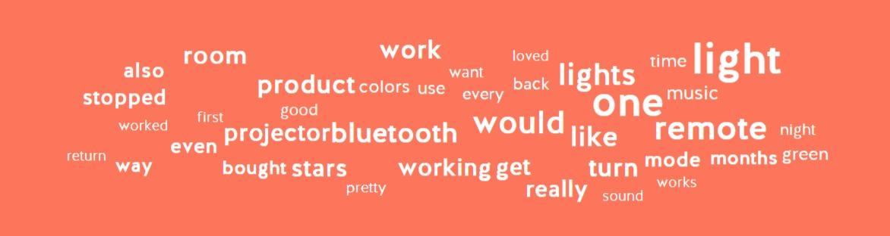
Insights
Reviews Insights
Second, we study the worst ratings (1-2 stars) to understand what should be fixed or highlighted to avoid disappointment in the buyer persona.
Suggested Image list
Insights
Insights

Slide 9
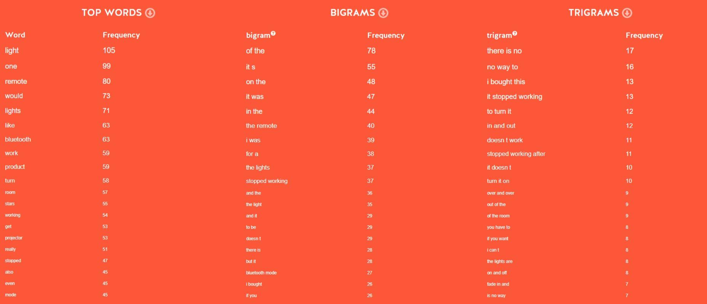
Insights
Reviews Insights
Suggested Image list
Insights
Insights

Slide 10




Insights
Benchmark Analysis
Suggested Image list
Insights
Insights

Slide 11

Suggested Image List
*
Suggested Image list
Additional Suggested Images
Hero Images

Slide 12
Suggested Image List
*
Suggested Image list
Additional Suggested Images
Hero Images

Slide 13

Reference
Suggested Image list
Additional Suggested Images
Hero Images

Slide 14
Suggested Image List
*
Suggested Image list
Additional Suggestd Images
Lifestyle

Slide 15
Suggested Image List
*
Suggested Image list
Additional Suggestd Images
Lifestyle

Slide 16

Reference
Suggested Image list
Additional Suggested Images
Hero Images

Slide 17
Suggested Image List
*
Suggested Image list
Additional Suggested Images
Infographics

Slide 18
Suggested Image List
*
Suggested Image list
Additional Suggested Images
Infographics

Slide 19

Reference
Suggested Image list
Additional Suggested Images
Hero Images

Slide 20
Suggested Module List for A+
*
Suggested Image list
Additional Suggested Images
A+ content

Slide 21
Suggested Module List for A+
*
Suggested Image list
Additional Suggested Images
A+ content

Slide 22
Suggested Concept: Listing Video
*
Additional Suggested Images
Suggested Image list
A+ content

Slide 23
Suggested Concept: Listing Video
*
Additional Suggested Images
Suggested Image list
A+ content

Slide 24
Suggested Concept: Premium A+ Content
*
Additional Suggested Images
Suggested Image list
A+ content

Slide 25
Suggested Concept: Premium A+ Content
*
Additional Suggested Images
Suggested Image list
A+ content

Slide 26
Suggested Concept: Premium A+ Video
*
Additional Suggested Images
Suggested Image list
A+ content

Slide 27
Suggested Concept: Premium A+ Video
*
Additional Suggested Images
Suggested Image list
A+ content

Slide 28
Suggested Concept: Sponsored Ads Video
*
Additional Suggested Images
Suggested Image list
A+ content

Slide 29
Suggested Concept: Sponsored Ads Video
*
Additional Suggested Images
Suggested Image list
A+ content

Slide 30
Suggested Concept: Brand Story
*
Additional Suggested Images
Suggested Image list
A+ content

Slide 31
Suggested Concept: Brand Story
*
Additional Suggested Images
Suggested Image list
A+ content

